Slide 1
CSS and Preprocessors

Slide 2
Learning Outcome
You will know about CSS Preprocessors
You will be able to write a less file and compile it
You will know about the main elements in a less file
You will be able to write an application where the styling changes dynamically.

Slide 3
Agenda
Introduction to CSS Preprocessors
Introduction to Less
Installation of npm and less
Creating a Stylesheet
Compiling it and linking it
Changing the layout dynamically in the web application
Exercises

Slide 4
Introduction to css preprocessors
CSS and Preprocessors

Slide 5
CSS Preprocessors
Less is a CSS pre-processor, meaning that it extends the CSS language.
Preprocessors allows for variables into a, normally, static CSS
Easy to change colors generally
Easy to re-style the entire application from a central point.
Increasing your productivity
Reusing existing modules

Slide 6
CSS Preprocessors
There are several CSS Preprocessors
LESS
SASS
STYLUS
In this course we will focus on LESS

Slide 7
Introduction to {less}
CSS and Preprocessors

Slide 8
Introducing {less}
{less} - http://lesscss.org
CSS Preprocessor
Running on JavaScript
Allows the use of variables inside your CSS
Important part of making a dynamic web application
Used in most CMS to help maintaining themes etc.

Slide 9
Introducing {less}
A less file can either be run on the server (manually) with a command line command, that compiles into a css file
The file is then generated before release, and not dynamically
A {less} file can also be run directly in the browser by using a JavaScript library for compiling it.
This typically has more performance overhead.
This allows for dynamic changes to the web application on run time.

Slide 10
Installing the Node Package Manager
Compiling the {less} file locally requires the node package manager (npm).
You might already have this one if you have Visual Studio Installed.
Check for NPM: search your computer for ”node.js command prompt” – opening the command prompt and type: npm
You should see a list of usage options.
Install the npm if you dont already have it.
https://nodejs.org/en/

Slide 11
Installing {less}
To compile {less} files you need to have {less} installed into the npm.
Open the node.js command prompt
Type: npm install -g less
Verify it has been installed by typing: lessc

Slide 12
Creating a stylesheet
CSS and Preprocessors

Slide 13
Creating a Stylesheet
Using one or more {less} files will allow you to use a variety of elements. We will look at the following elements:
Using variables in {less}
Using Mixins in {less}
Using Nested Styles in {less}
Importing other {less} files

Slide 14
Creatig a stylesheet
The .less file is during development compiled into a css file. This means that we will include the compiled .css file into our HTML files
Compiling the .less file to a .css file is done using the {less} compiler: lessc.
This command will compile the styles.less to the styles.css file.
> lessc styles.less styles.css
Simple syntax, invoking the less compiler and outputting the .css file. (this can be done automatically)

Slide 15
Variables in {less}
You can define variables and reuse these variables in your stylesheet. When the .less is compiled, it replaces the variables with the proper values.
@basecolor: "#DDD";
html
{
background-color: @basecolor;
}

Slide 16
Mixin in {less}
A mixin is a way of reusing smaller parts of your {less} codes in existing groups. Its possible to reuse a group within a group.
@basecolor: "#DDD";
@highlightcolor: "#FF00FF"; //variable
Html
{
background-color: @basecolor;
.highlight //mixin
}
.highlight
{
background-color:@highlightcolor;
}

Slide 17
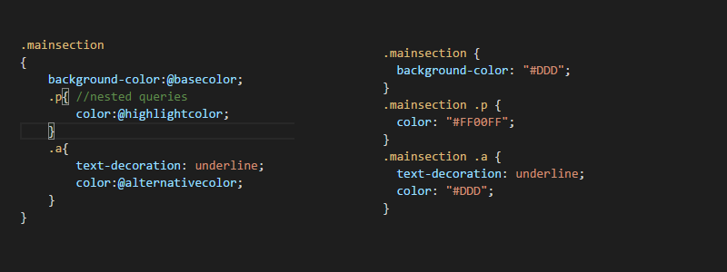
Nested styles in {less}
Nested styles provides an easier and more convenient method of determining the rules that are applied to the CSS / HTML

Slide 18
Importing in {less}
Importing a {less} file or a css files allows you to access shared variables across multiple files.
In the development phase you have a well structured environment, easy to reuse.
Allows you to import variables etc. From another file.
> @import "typography"; //import of stylesheet
>@import "typography.css";

Slide 19
Exercises
CSS and Preprocessors

Slide 20
Exercises
Create a new {less} stylesheet and compile it to CSS.
Include the new stylesheets in your project.
Use both
Variables
Mixin
Nested Styles
Imports
For development purpose try to investigate into runtime {less} compiling
Investigate other alternatives to {less}

